Slide 1
INTRODUCTION TO MICROWAVE ENGINEERING
BY CANDIDA MWISOMBA

Slide 2
Definition:
The field of radio frequency (RF) and microwave engineering generally covers the behavior of alternating current signals with frequencies in the range of 100 MHz (1 MHz = 106 Hz) to 1000 GHz (1 GHz = 109 Hz).
RF frequencies range from very high frequency (VHF) (30–300 MHz) to ultra high frequency (UHF) (300–3000 MHz).
While the term microwave is typically used for frequencies between 3 and 300 GHz, with a corresponding electrical wavelength between λ = c/f = 10 cm and λ = 1 mm, respectively.

Slide 3
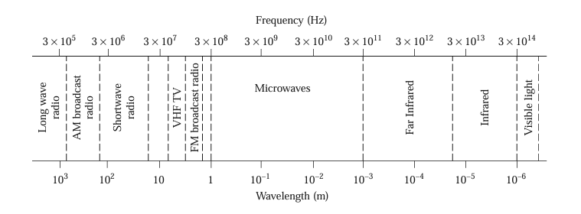
Electromagnetic Spectrum

Slide 4
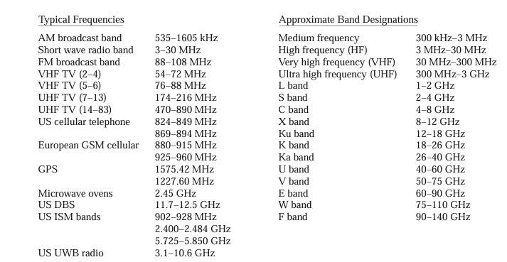
Electromagnetic Spectrum

Slide 5
Applications
Remote sensing
Medical diagnostics and treatment eg Microwave radiometry
Heating methods
Wireless Networking and communication systems
Radars systems e.g for Weather prediction

Slide 6
Short History
The foundations of modern electromagnetic theory were formulated in 1873 by James Clerk Maxwell, who hypothesized, solely from mathematical considerations, electromagnetic wave propagation and the idea that light was a form of electromagnetic energy.
Maxwell’s formulation was cast in its modern form by Oliver Heaviside during the period from 1885 to 1887. Heaviside was a reclusive genius whose efforts removed many of the mathematical complexities of Maxwell’s theory, introduced vector notation, and provided a foundation for practical applications of guided waves and transmission lines.

Slide 7
Short History…
Heinrich Hertz, a German professor of physics and a gifted experimentalist who understood the theory published by Maxwell, carried out a set of experiments during the period 1887–1891 that validated Maxwell’s theory of electromagnetic waves.
Because of the lack of reliable microwave sources and other components, the rapid growth of radio technology in the early 1900s occurred primarily in the HF to VHF range.
It was not until the 1940s and the advent of radar development during World War II that microwave theory and technology received substantial interest.

Slide 8
Short History…
In the United States, the Radiation Laboratory was established at the Massachusetts Institute of Technology to develop radar theory and practice.
A number of talented scientists, including N. Marcuvitz, I. I. Rabi, J. S. Schwinger, H. A. Bethe, E. M. Purcell, C. G. Montgomery, and R. H. Dicke, among others, gathered for a very intensive period of development in the microwave field.
Communications systems using microwave technology began to be developed soon after the birth of radar, benefiting from much of the work that was originally done for radar systems.

Slide 9
Short History…
The advantages offered by microwave systems, including wide bandwidths and line-of-sight propagation, have proved to be critical for both terrestrial and satellite communications systems and have thus provided an impetus for the continuing development of low-cost miniaturized microwave components.

Slide 10
Maxwell’s equations
Electric and magnetic phenomena at the macroscopic level are described by Maxwell’s equations, as published by Maxwell in 1873.
This work summarized the state of electromagnetic science at that time and hypothesized from theoretical considerations the existence of the electrical displacement current, which led to the experimental discovery by Hertz of electromagnetic wave propagation.
Maxwell’s work was based on a large body of empirical and theoretical knowledge developed by Gauss, Ampere, Faraday, and others.

Slide 11
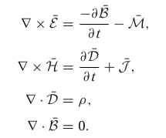
Maxwell’s equations
The general form of time varying Maxwell equations, then, can be written in “point,” or differential, form as:

